Slide 1
WEEK 8 presentation by: VIVIAN MWANGI &
MARK ODHIAMBO

Slide 2
#105 {The recovery system (RESEARCH) }
The purpose is to ensure that during the launching stage of the rocket, we are able to recover the rocket with its parts intact and to avoid it from crashing.
The main aim for the recovery system being incorporated in the rocket is to ensure a safe landing.

Slide 3
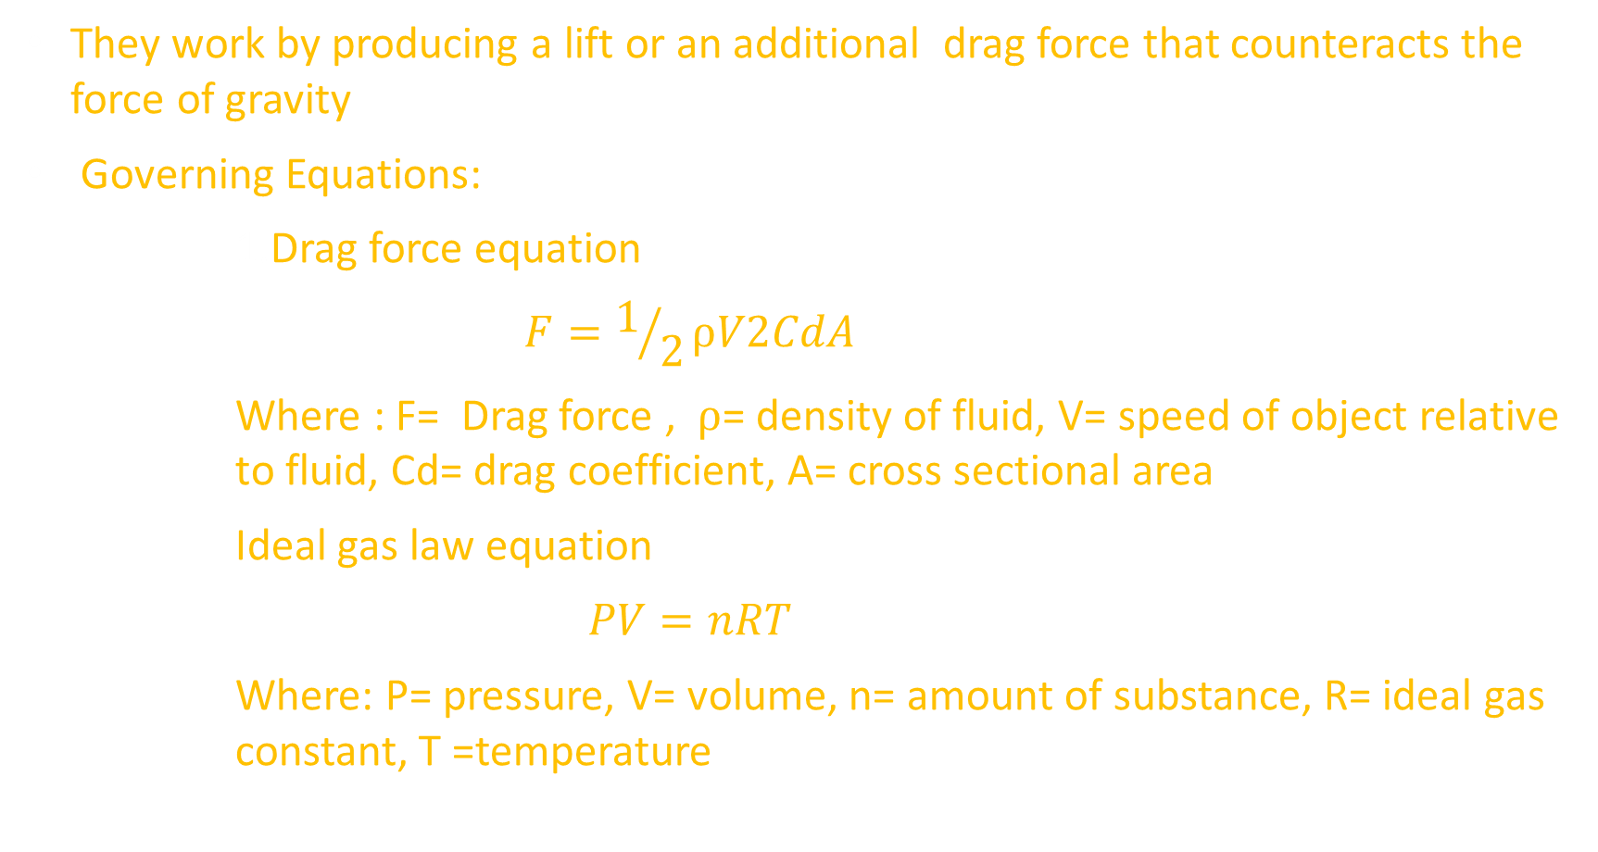
How they work
They work by producing a lift or an additional drag force that counteracts the force of gravity
Governing Equations:
      Drag force equation
      $$F=1/2⍴V2CdA$$
      Where : F= Drag force , ⍴= density of fluid, V= speed of object relative to fluid, Cd= drag coefficient, A= cross sectional area
      Ideal gas law equation
      $$PV=nRT$$
      Where: P= pressure, V= volume, n= amount of substance, R= ideal gas constant, T =temperature

Slide 4
Types of recovery systems
Parachute recovery
Streamer recovery
Featherweight/ tumble recovery
Rocket glide recovery
Helicopter recovery
Umbrella recovery

Slide 5
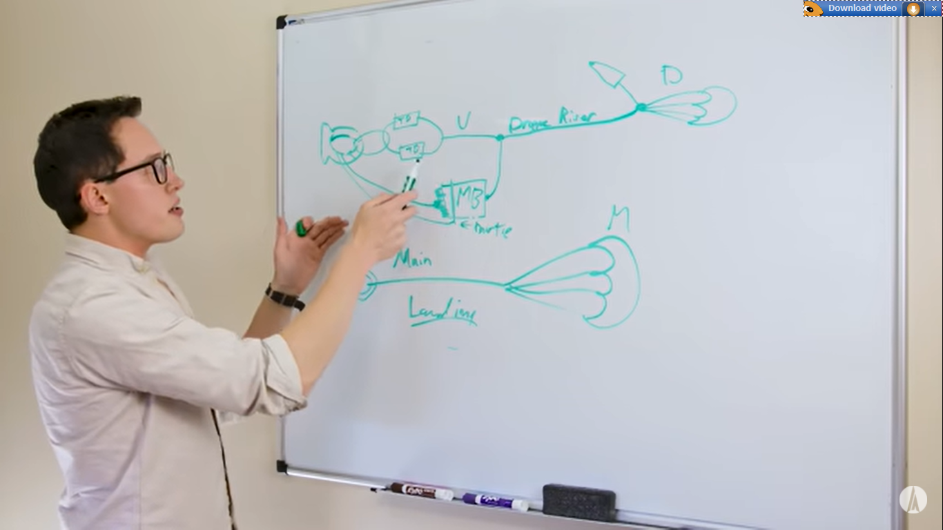
Recovery system
We settled on parachute recovery.
consists of:
Parachute
Connecting (shroud) lines
shock chords
Summary of a recovery system

Slide 6
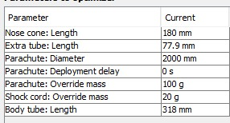
Parachute design parameters
  To determine the design parameters for the parachute we took into consideration the following:
  Apogee
  Materials to use
  Time of flight& when to deploy the parachute
  Ejection charge required for deployment
  Equations taken into consideration:
  Drag force equation
  Ideal gas law equation
FOR THE TEST DRIVE

Slide 7
MATERIAL SELECTION AND DIMENSIONS
Parachute canopy - Material to be used was selected to be Nylon since it has excellent wind resistance, good elasticity, mildew resistance, and is comparatively cheaper. The material is also lightweight and dries quickly.
Length of the lines – we shall use Nylon fiber is so strong and elastic
Shock chords –we shall used rubber bands
SINGLE PARACHUTE: For smaller rockets travelling to a height of approximately 500ft. (152.4m)
DUAL PARACHUTE: suitable for launching above this height
  Employs use of 2 different sizes of parachutes:
  1. Drogue chute -1st to be deployed. Smaller S.A than the main chute
  This allows the drogue to stay intact as the rocket begins the initial descent
  2.. Main chute – larger S.A than the drogue chute
  Ensures safe descent at a slower speed

Slide 8
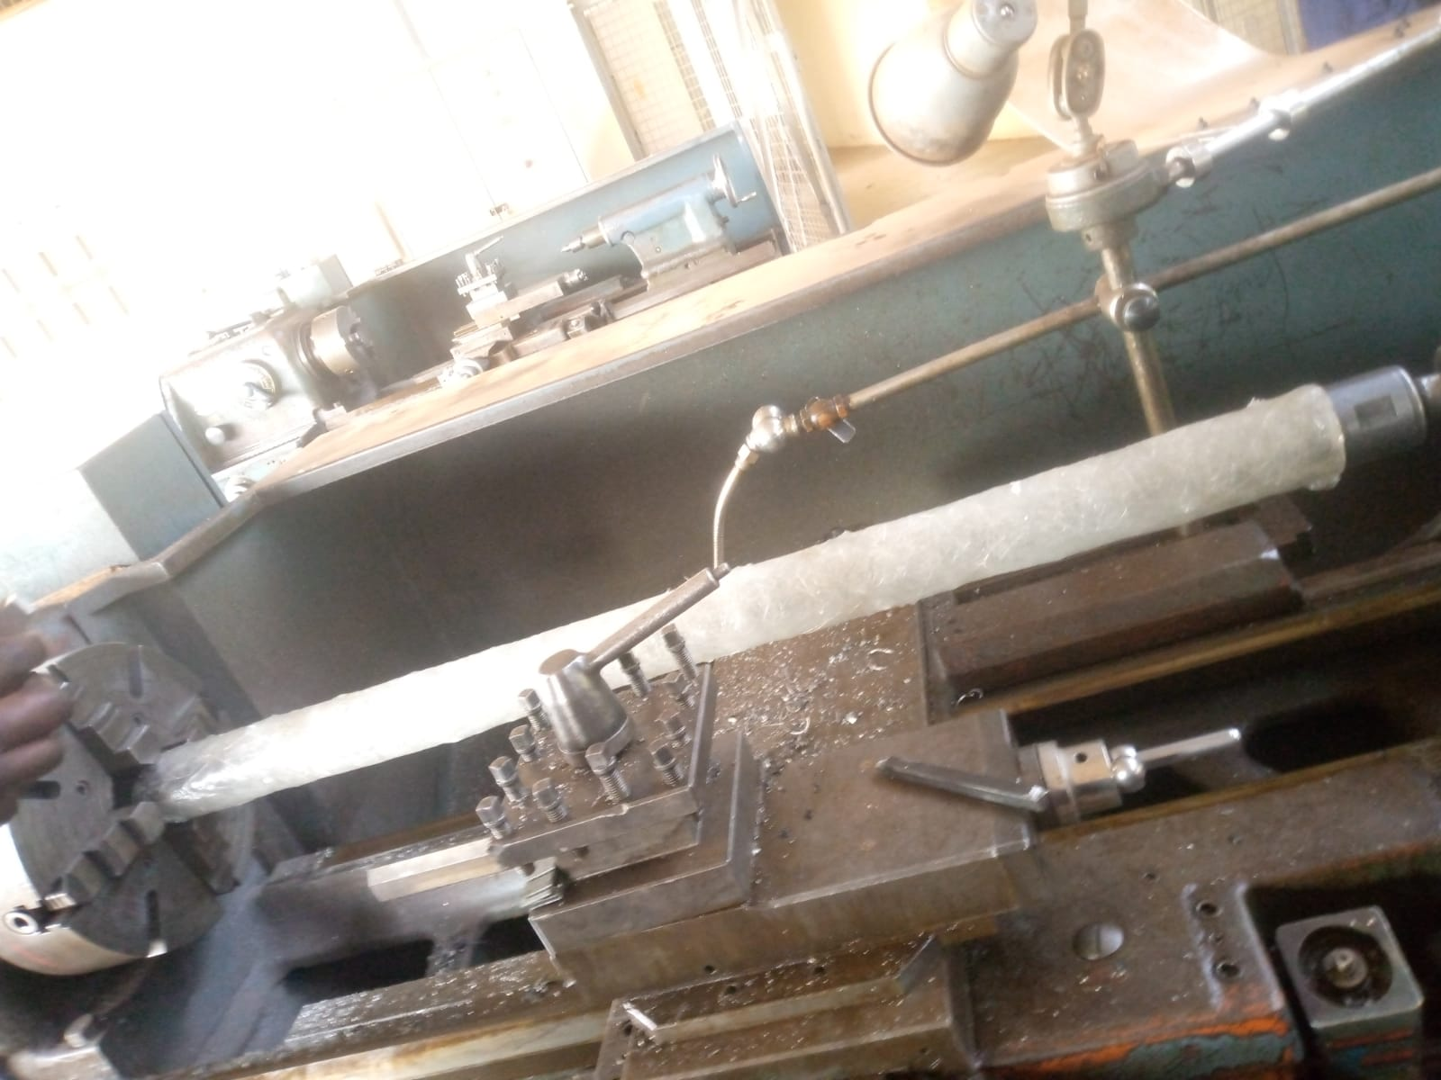
#117 {Post Fabrication of the Body Tube}
We attempted to carry out post fabrication of the body tube where turning was required to reduce the thickness to 2mm but it was unsuccessful due to the stress forces applied to the tube during clamping, the material appeared brittle thus we opted to use alternative means to obtain the required thickness.
Recommendation: To take into serious account the required measurements during original fabrication and try obtaining a thickness approximately equal to the desired one.

Slide 9
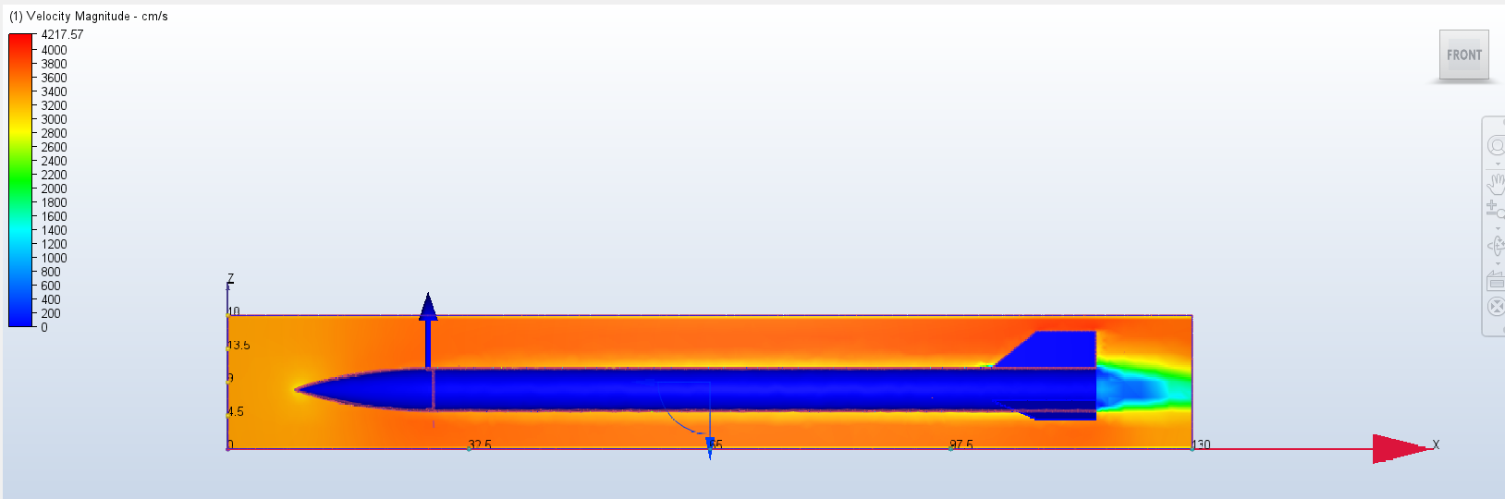
Github #93 {CFD SIMULATION.}
The CFD simulation was attempted in ANSYS but due to several errors it wasn’t able, we then changed to CFD Autodesk and were able to get some data.
Velocity magnitude.

Slide 10
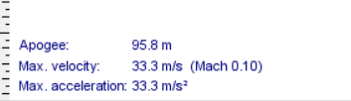
From the scale the velocity magnitude can be seen to relate to the Open Rocket design.

Slide 11
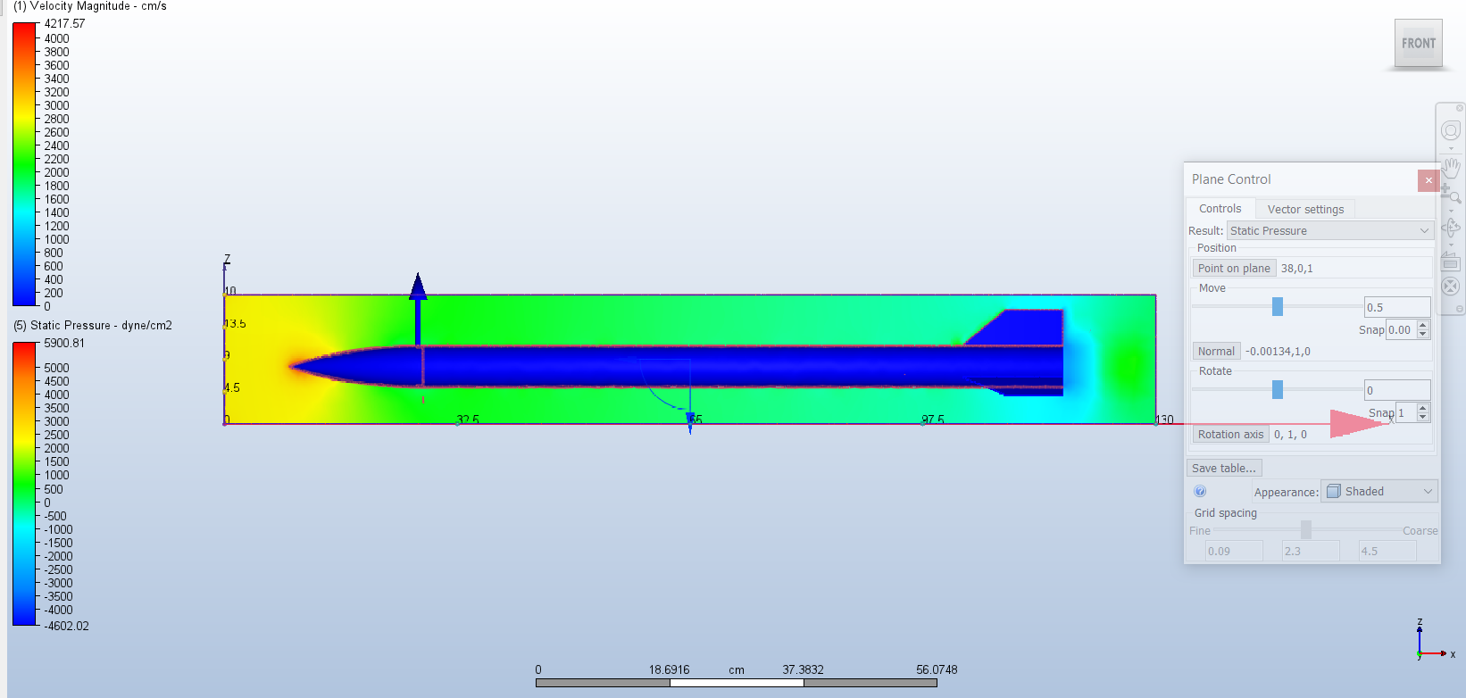
Static pressure.
From the simulation the pressure was found to be highest at the tip of the cone.

Slide 12
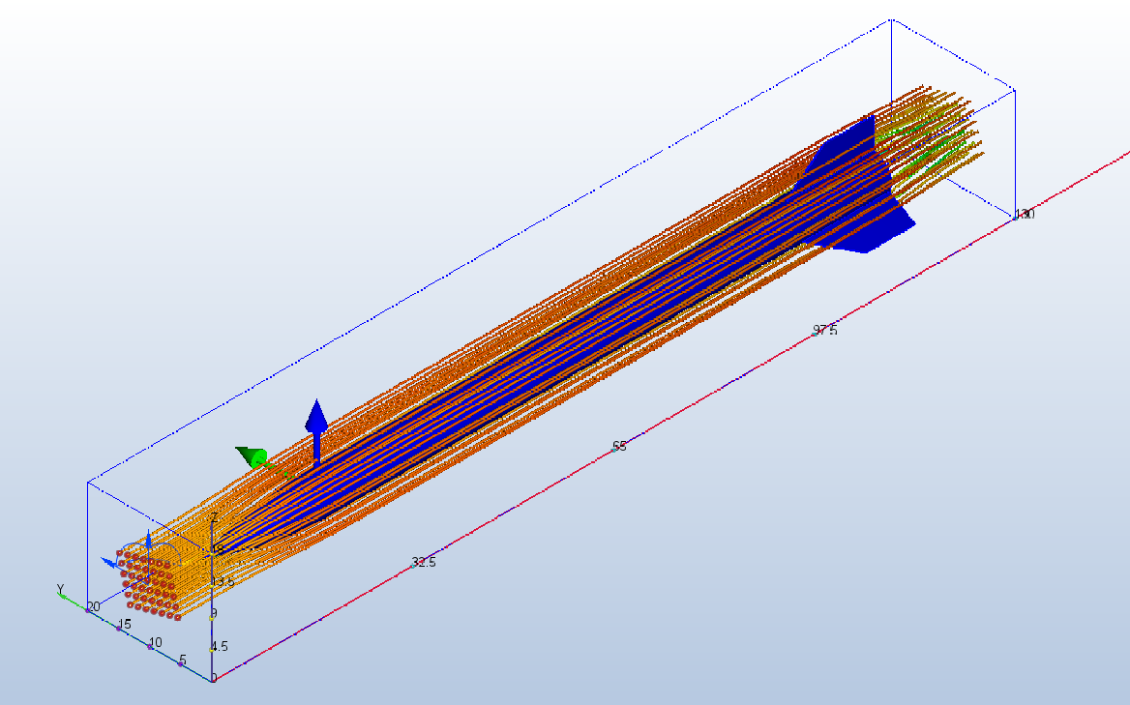
Traces
The air lines where traced to show the flow of air line on the model.

Slide 13
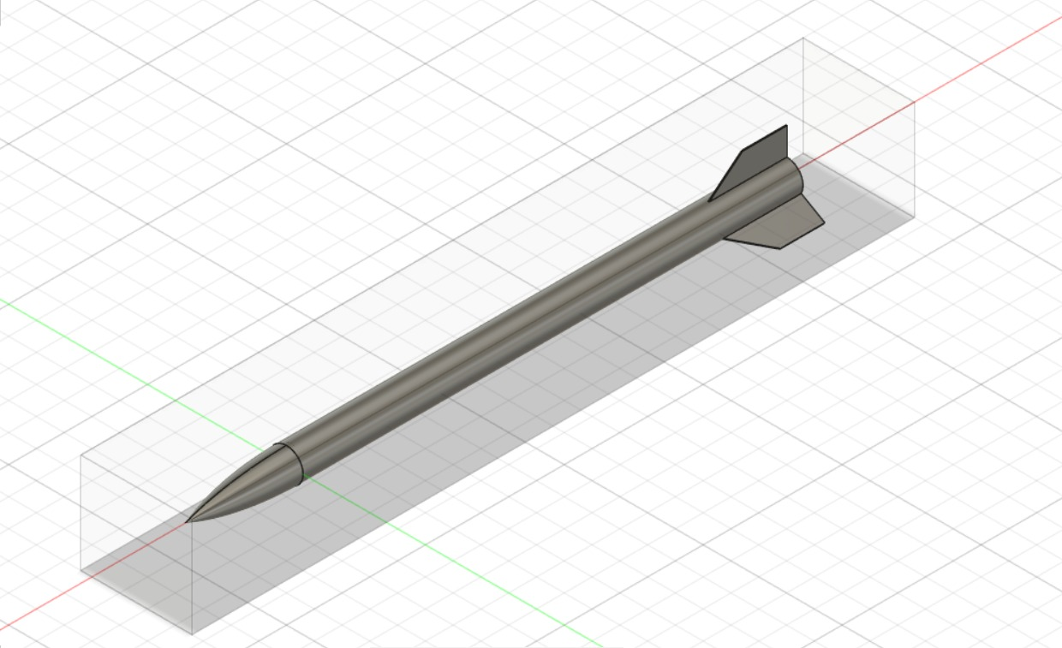
#114 {UPDATED CAD DESIGN}

Slide 14
Tasks to be done this week
{Recovery system fabrication.} #137
{Nose cone fabrication} #138
{Fin set fabrication}#139

Slide 15
Thank you!
-The end-

